Slide 1

Parallel and Distributed/Cloud Computing
Class: BS(CS)-VIII
Sukkur IBA University – Kandhkot Campus Week - 02
Lecture – 03 & 04

Slide 2
Recap
Computing
Distributed Computing
Cluster Computing
Grid Computing
Utility Computing

Slide 3
Cloud Computing

Slide 4
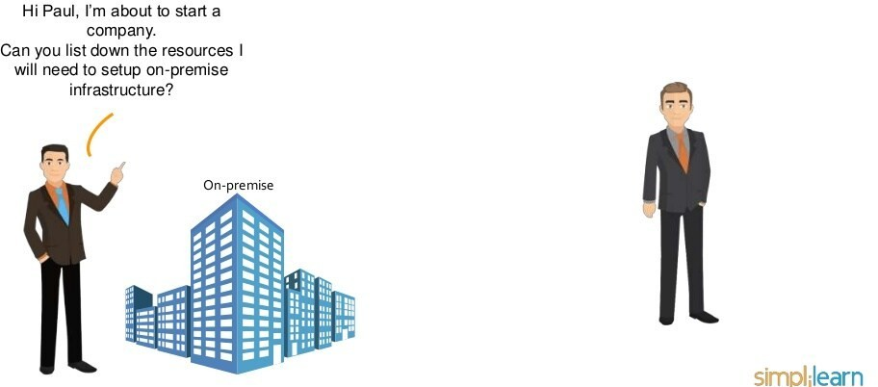
Why Cloud Computing?

Slide 5
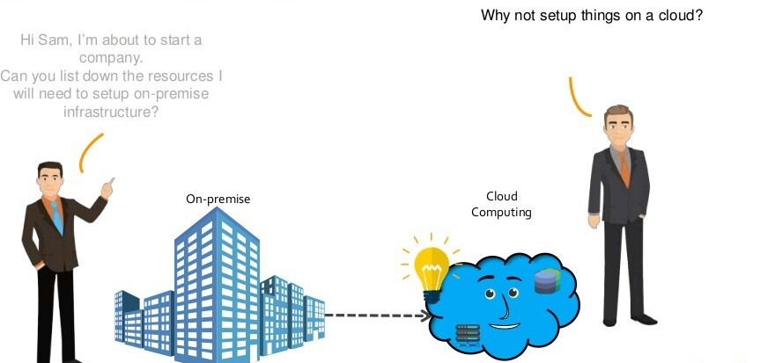
Why Cloud Computing?

Slide 6
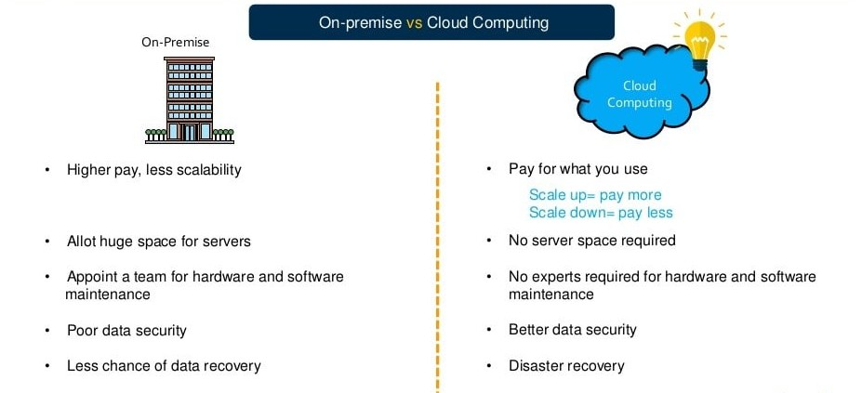
Why Cloud Computing?

Slide 7
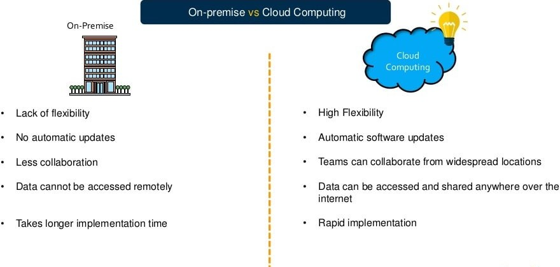
Why Cloud Computing?

Slide 8
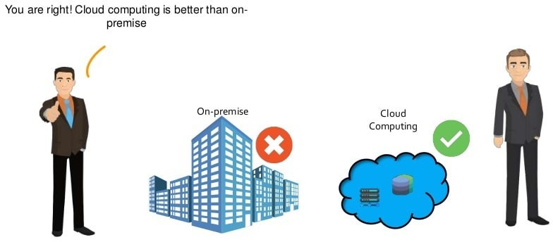
Why Cloud Computing?

Slide 9
Why Cloud Computing?
Pay As You Go
Lower Total Cost of Ownership
(TCO)
24x7 Support
Reliability, Scalability
Why Cloud Computing?
Device- & Location-Indep endent
Lower Capital Expenditure
Easy & Agile Deployment
Free Up Internal Resources
Utility Based
Highly Automated

Slide 10
What is Cloud Computing?
“The practice of using a network of remote servers hosted on the Internet to store, manage, and process data, rather than a local server or a personal computer.”
Oxford Dictionary
“The practice of storing regularly used computer data on multiple servers that can be accessed through the Internet.”
Webster Dictionary

Slide 11
What is Cloud Computing?
Cloud computing is a model for enabling ubiquitous, convenient,
on-demand network access to a shared pool of configurable computing resources (e.g., networks, servers, storage, applications, and services) that can be rapidly provisioned and released with minimal management effort or service provider interaction. This cloud model is composed of five essential characteristics, three service models, and four deployment models.
National Institute of Standards and Technology

Slide 12
Evolution of Cloud Computing
Stage | Characteristics
Grid Computing | Solving large problems with parallel computing
Utility Computing | Computing resources offered as a metered service Late 1990s
Software as a Service | Subscription-based software accessed over the Internet Gained momentum after 2001
Cloud Computing | Next-generation datacenters with virtualization technology Full stack of service - IasS, PaaS, & SaaS
Order of Evolution

Slide 13
Key Enabling Technologies
Ubiquitous fast wide-area networks
Powerful and inexpensive servers
High-performance virtualization technology
Hadoop Linux Web Hosting
Microsoft SQL Server Windows
Windows Server
Virtualization
Widespread Broadband

Slide 14
Five Key Cloud Characteristics
On-demand self-service
Ubiquitous network access
Location-independent resource pooling
Rapid elasticity
Pay for what you use

Slide 15
Types of Cloud Computing

Slide 16
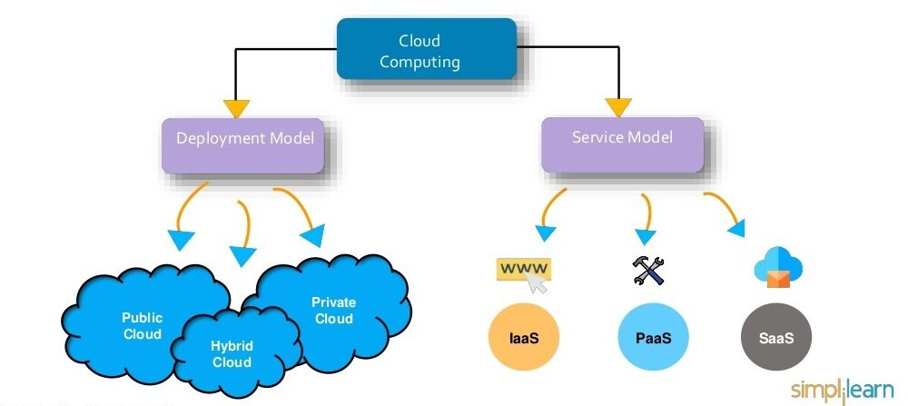
Types of Cloud Computing

Slide 17
Deployment Models

Slide 18
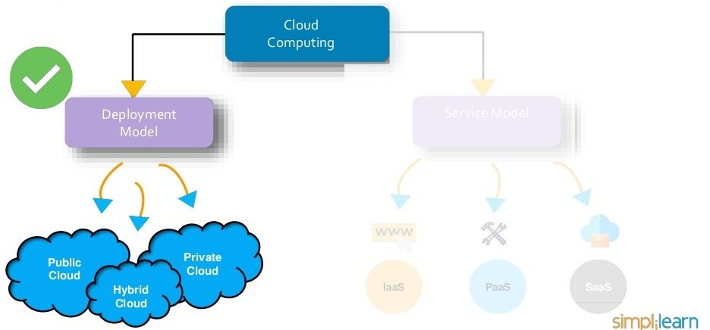
Deployment Models

Slide 19
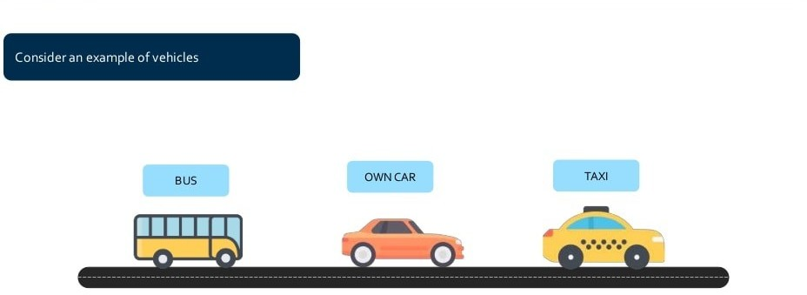
Types of Deployment Models

Slide 20
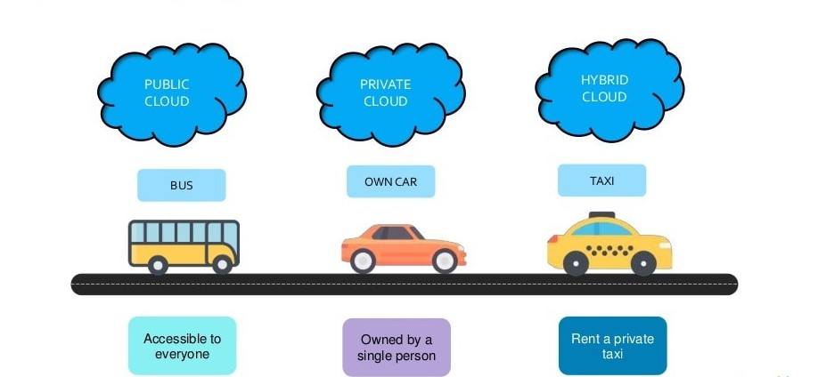
Types of Deployment Models

Slide 21
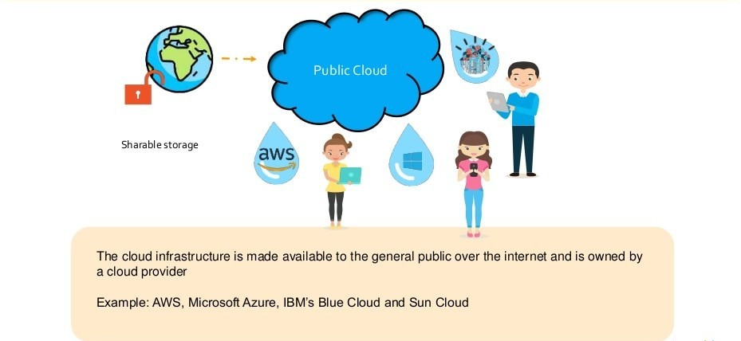
Public Cloud

Slide 22
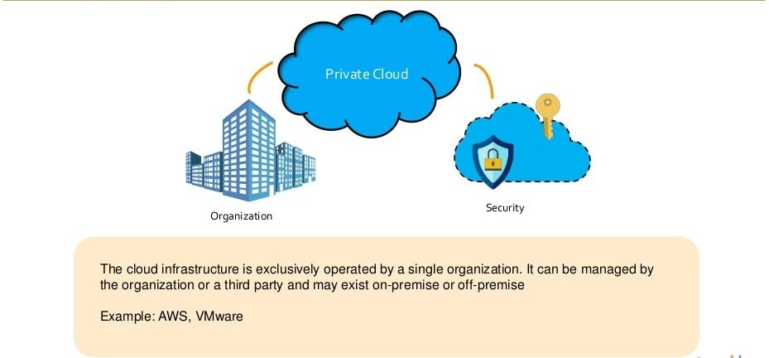
Private Cloud

Slide 23
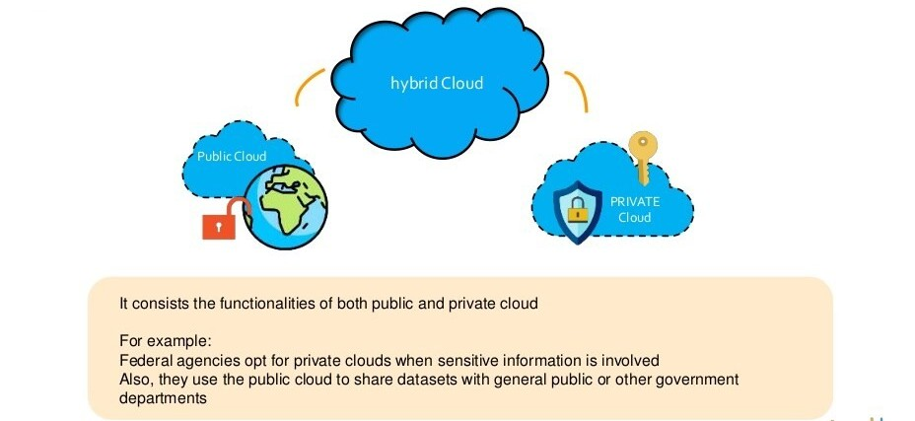
Hybrid Cloud

Slide 24
Service Models

Slide 25
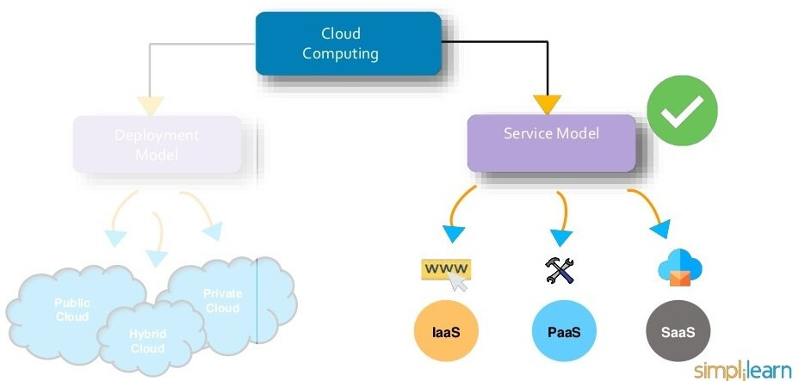
Types of Service Models

Slide 26
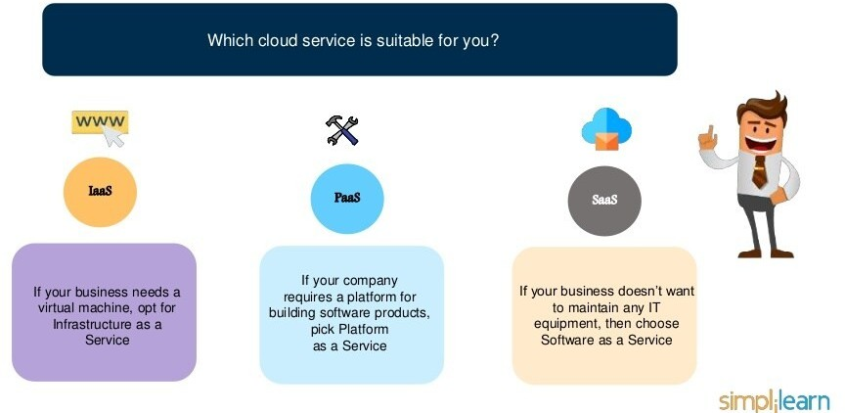
Types of Service Models

Slide 27
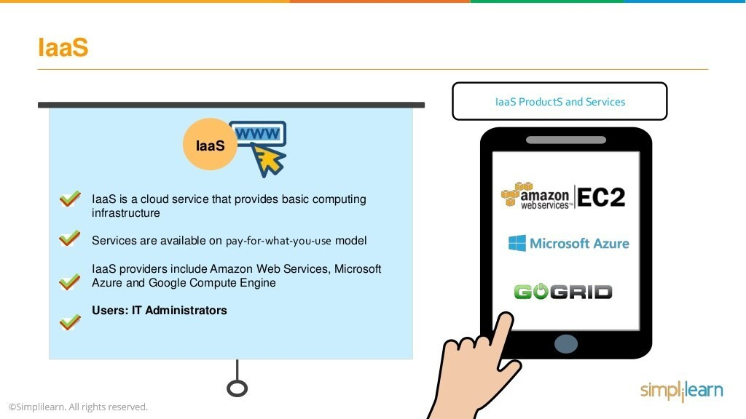
IaaS

Slide 28
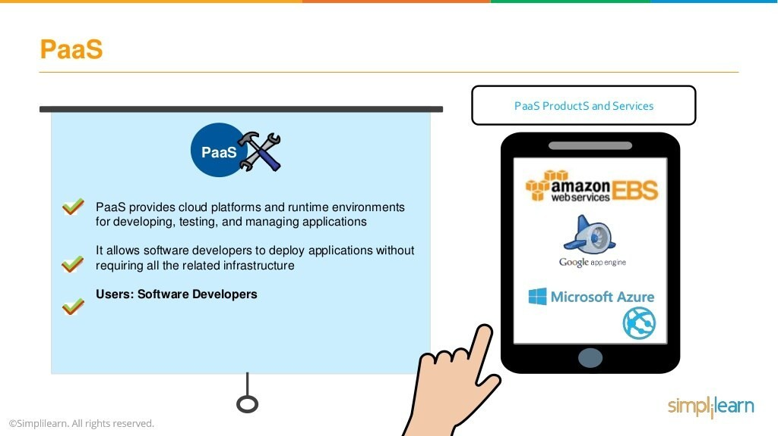

Slide 29
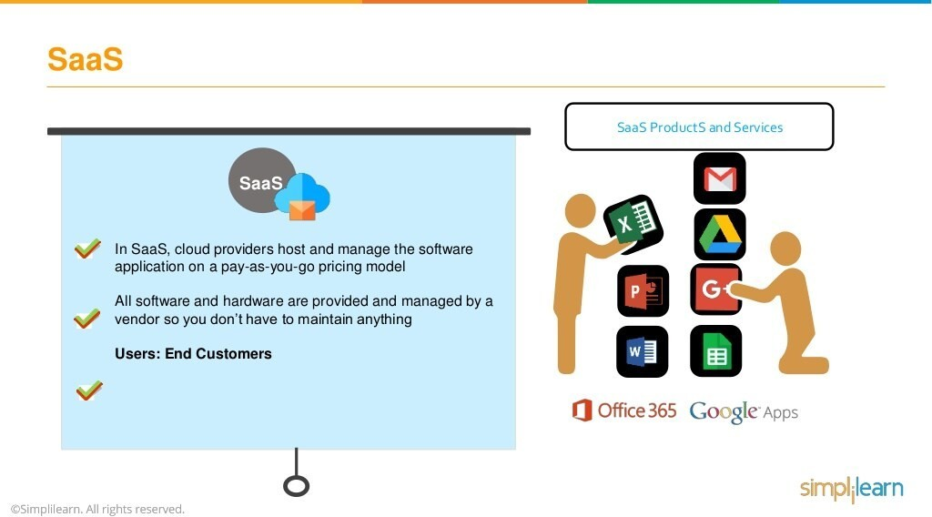

Slide 30
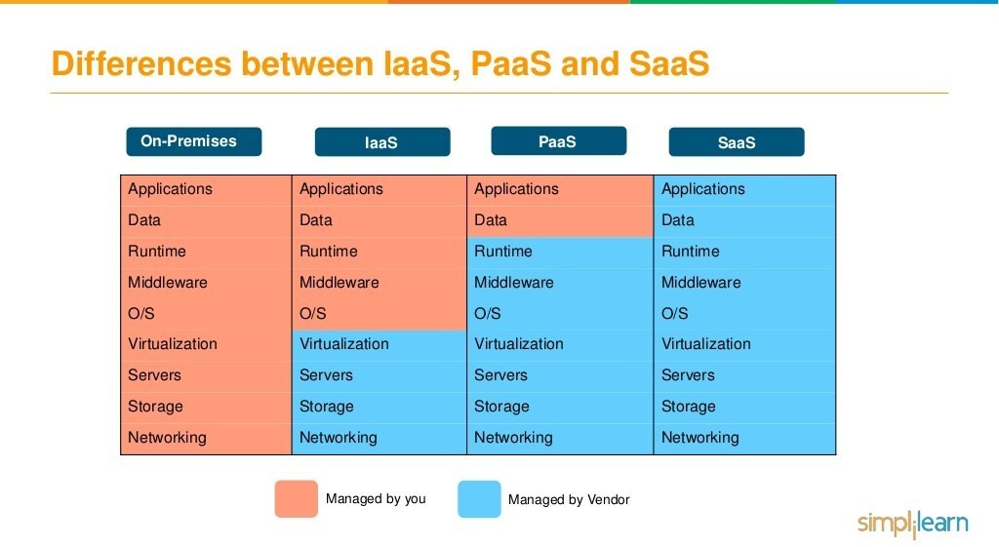

Slide 31
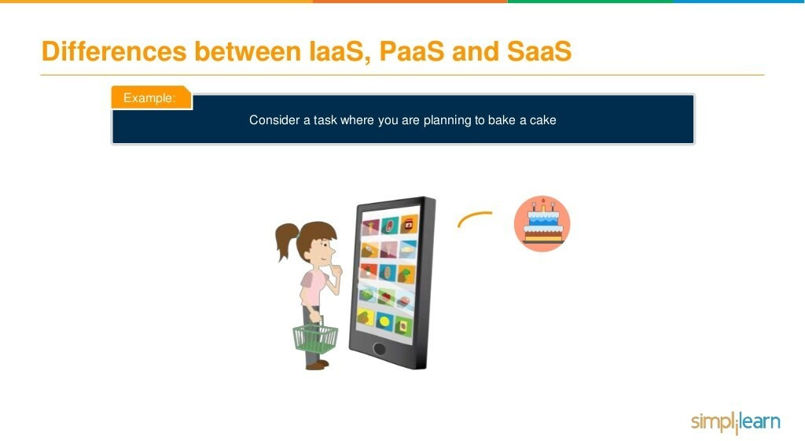

Slide 32
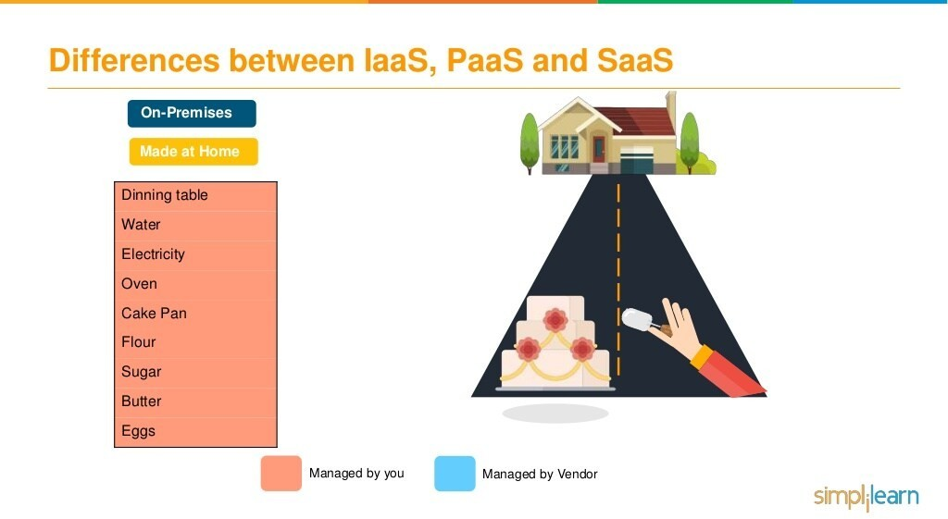

Slide 33
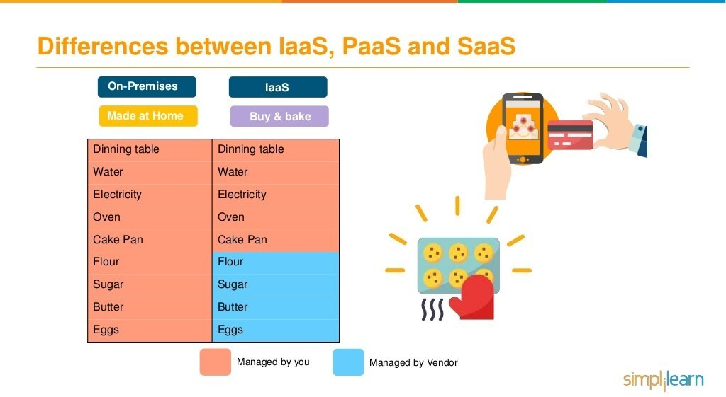

Slide 34
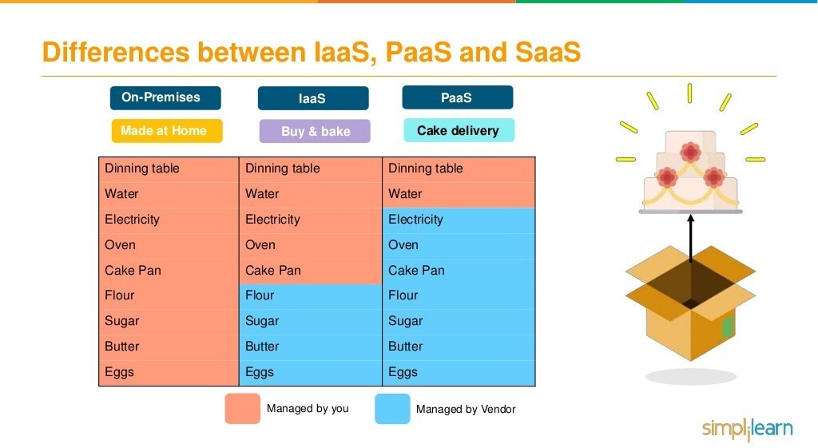

Slide 35
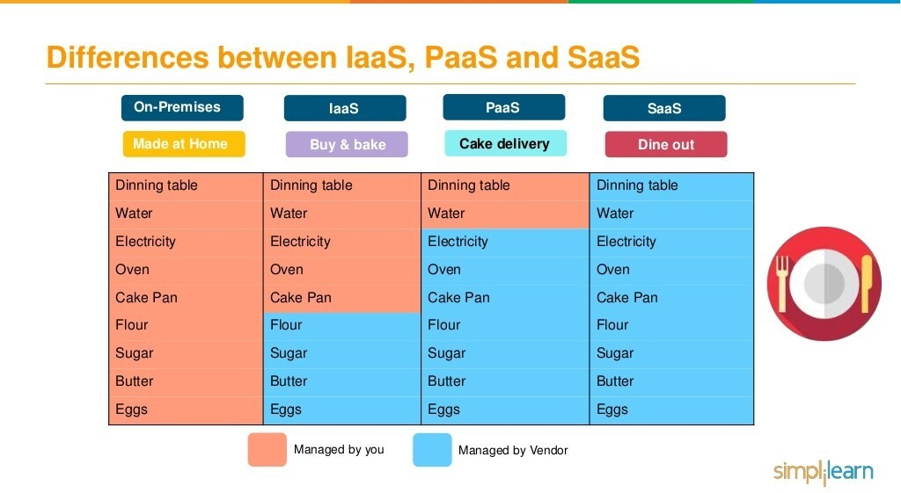

Slide 36
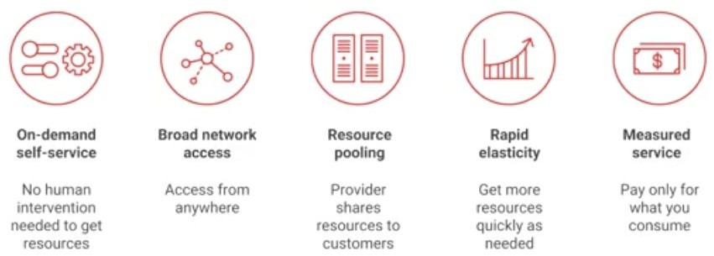
Essentials Characteristics of Cloud Computing

Slide 37
Common Characteristics
Massive Scale
Resilient Computing
Homogeneity
Geographic Distribution
Virtualization
Service Orientation
Low Cost Software
New Cloud Programming Paradigms: MapReduce/Hadoop, NoSQL/Cassandra/MongoDB and many others

Slide 38

Typical Computing Pattern
On & off workloads
Batch jobs
On and Off
Wasted Capacity
Compute
Inactivity Period
Time to market can be cumbersome
Time

Slide 39
Typical Computing Pattern
Rapid Growth
Rapidly growing company
Major challenge for IT dept. to keep up with growth
Potential loss of business opportunity
Potential customer service problems
Compute
Time

Slide 40
Typical Computing Pattern
Unexpected peak in demand
Unpredictable Bursting
Loss of business opportunity
Wasted capacity if demand wanes
Compute
Time

Slide 41
Typical Computing Pattern
Seasonal peaks and troughs
Predictable Bursting
Provisioning dilemma
Wasted capacity or
Loss of business
Compute
Time

Slide 42
Cloud Computing Examples
A large enterprise quickly & economically deploys new internal applications to its distributed workforce.
An e-commerce website accommodates sudden demand for a “hot” product caused by a viral buzz.
A pharmaceutical research firm executes large-scale simulations using computing power provided by cloud vendors.
A media company serves unlimited video, music, and other media to their worldwide customer base.

Slide 43
Cloud Computing Nutshell
End-users connect over the Internet to the cloud from their own personal computers or portable devices in order to access services.
To the end-user, the underlying infrastructure such as the hardware, operating system, etc., is invisible
Servers
Laptops
Desktop
Application Platform Infrastructure
Phones
Tablets
Cloud Computing

Slide 44
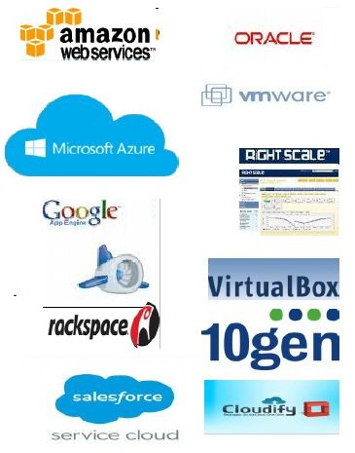
Many Cloud Providers
AWS: Amazon Web Services
EC2: Elastic Compute Cloud
S3: Simple Storage Service
EBS: Elastic Block Storage
Microsoft Azure
Google Compute Engine/AppEngine
Rightscale, Salesforce, EMC,
Gigaspaces, 10gen, Datastax, Oracle,
VMWare, Yahoo, Cloudera
And 100s more…

Slide 45
Cloud-Sourcing
Why is it becoming important?
Using high-scale/low-cost providers,
Any time/place access via web browser,
Rapid scalability; incremental cost and load sharing,
Can forget need to focus on local IT.
Concerns:
Performance, reliability, and SLAs,
Control of data, and service parameters,
Application features and choices,
Interaction between Cloud providers,
No standard API – mix of SOAP and REST!
Privacy, security, compliance, trust…

Slide 46
Advantages of Cloud Computing
Lower computer costs
No need of a high-powered and high-priced computer to run cloud computing's web-based applications
Improved performance
Cloud computing system boot and run faster because they have fewer programs and processes loaded into memory
Reduced software costs
No need to purchase expensive software applications

Slide 47
Advantages of Cloud Computing
Instant software updates
Unlimited storage capacity
Increased data reliability (crash of hard drive destroy valuable data)
Universal information access
Latest version availability
Easier group collaboration
Device independence

Slide 48
Disadvantages of Cloud Computing
Requires a constant internet connection
Does not work well with low-speed connections
Features might be limited
Application Can be slow
Stored data might not be secured
Stored data can be lost!
Not clear that you can run compute-intensive HPC applications that use MPI/OpenMP
General Concerns
Each cloud systems uses different protocols and different APIs
may not be possible to run applications between cloud based systems
Amazon has created its own DB system (not SQL 92), and workflow system (many popular workflow systems out there)
so your normal applications will have to be adapted to execute on these platforms.

Slide 49
Thank you!
Any Questions???
49

